Slide 1
Aqua Game
multiplayer games

Slide 2
About Me
HOBBIES
I am a technology teacher, I teach students from 11 years old to 18 years old and I can assure you that this is the subject most loved by students, at the moment I am following a bootcamp at Ironhack of web development, after that I would like to work in the field of development whatever the technology proposed I am ready to learn more
HISTORY
SPORTS
VIDEOGAME
NEWTECH

Slide 3
WHOA!
my project is to create a game at the end of two weeks during the hours of the bootcamp, that means a simple and fun game at the same time.

Slide 4
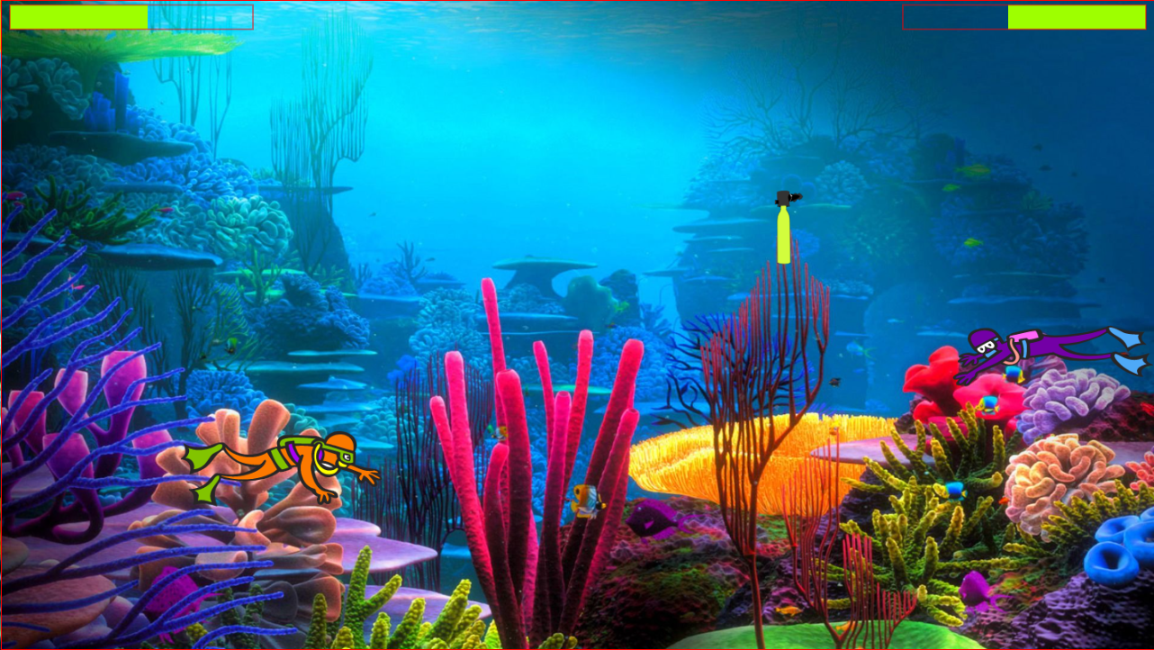
How does it work?
The game I'm going to present you is a multiplayer game with two different characters and very simple to play, each player must recover first the oxygen bottle to replace the bottle he already has, the player who has no oxygen loses and joins the dancers of the coffin.
oxygen
the bottles that we have Player 1 & 2
Color red on 20% of the rest
MERCURY
Player 1 & 2
Mercury is the closest planet to the Sun
you have to use the keyboard to play
I chose it because it's a game that doesn't exist on the net and that has been imagined by my students of the middle school

Slide 5
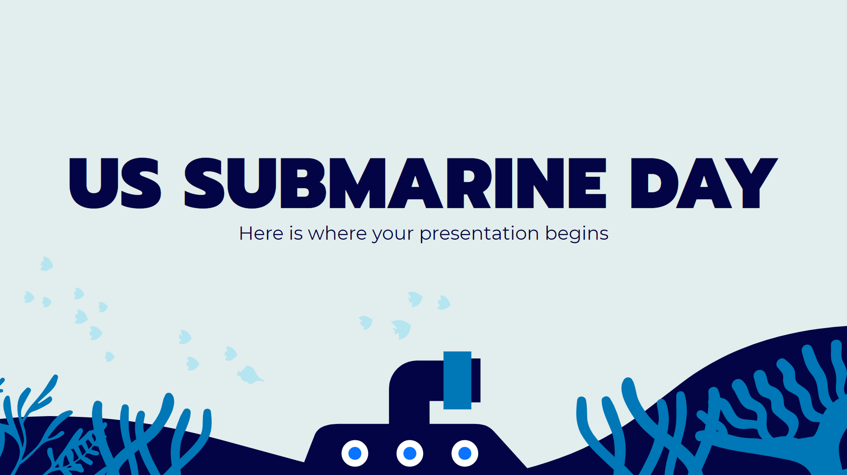
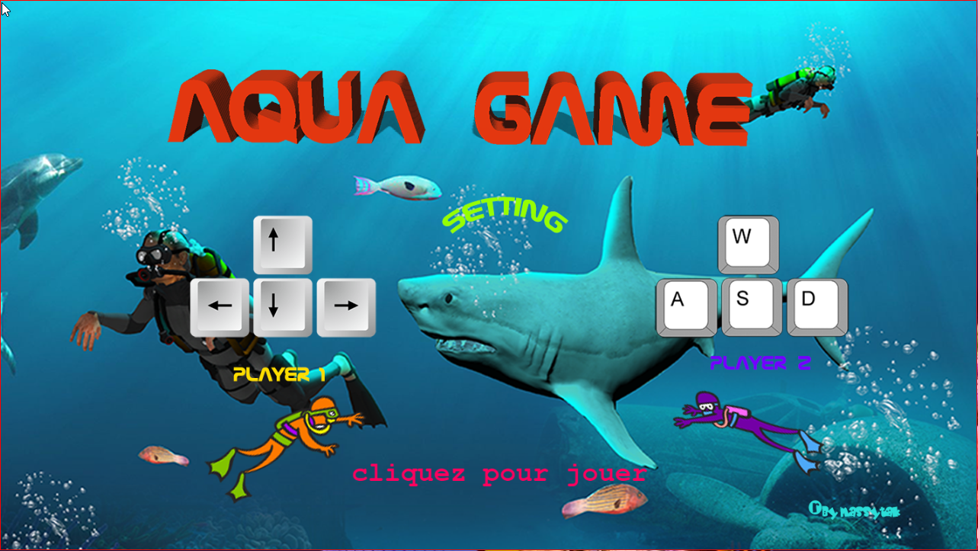
Technical Challenge
The challenge I set myself was to create a fluid game with animation, that would attract players of a certain age to play as a duo and above all that it would be fun.

Slide 6

Big Mistake
I thought of several things to add to my game, but time was short, I spent a lot of time debugging my code than advancing in my script.
The thing I learned is to anticipate the code time well.

Slide 7
RESOURCES
Url Game : WWW.MASSYTAK.FR
PHOTOS
WEBSITE
https://unsplash.com
https://www.freepng.fr
https://fr.freepik.com/photos-vecteurs-libre/free-png
https://www.youtube.com //From Scratch – DéveloppementWeb
https://www.w3schools.com
https://developer.mozilla.org

Slide 8
THANKS!
Do you have any questions?
massi.messalti@gmail.com
+33781207351
Ironhack.com
Massytak

